Slide 1

Housing Amenities Impact on Apartment Listing Prices in the Southern USA
Final Presentation
Submitted by Gordon Oboh
July 25, 2026

Slide 2


1. Project Overview
Business Problem
Business Goal
Renters and property stakeholders in the Southern US lack clarity on which amenities and features truly drive rental pricing, making it difficult to price listings competitively or decide which property improvements yield the best return.
Identify the key features that influence rental prices for apartments in the Southern USA so that landlords, property managers, and renters can make data-informed pricing and investment decisions.
Data Mining Goals
Background
Build and compare three ensemble regression models (Random Forest, HistGradientBoosting, XGBoost) to predict rental price from property features
Determine the relative importance of each amenity feature in driving predicted price, producing an actionable ranking for investors and property managers
~385K Craigslist rental listings across 50 US states, filtered to ~150K apartment listings in 17 Southern states. The rental market is opaque — this analysis brings data-driven transparency.

Slide 3
2. Summary of Each Phase
Phase 1 — Business Understanding
Defined the business problem: what drives apartment rental prices in the Southern US?
Established success criteria: model can identify the top amenity drivers of rental price, producing rankings actionable for renovation prioritization and pricing strategy
Created project plan with timeline across all 6 CRISP-DM phases
Phase 2 — Data Understanding
Collected ~385K Craigslist listings from Kaggle (Austin Reese dataset)
Explored distributions of price, sqft, beds, baths; mapped geographic spread
Identified data quality issues: missing values in amenity columns, geographic outliers (non-US coordinates), extreme price outliers

Slide 4
2. Summary of Each Phase
Phase 3 — Data Preparation
Filtered to Southern states per Census Bureau definition (17 states: AL, AR, DC, DE, FL, GA, KY, LA, MD, MS, NC, OK, SC, TN, TX, VA, WV) plus lat/lon bounding box
Dropped irrelevant columns (id, url, image_url, description)
IQR-based price filtering per region to remove extreme outliers
Target encoding for high-cardinality categoricals (state, region, laundry/parking options)
K-Means clustering on lat/lon (148 clusters) to capture micro-location effects
Final dataset: ~150K apartment listings with engineered features
Phase 4 — Modeling
Three ensemble regressors: Random Forest, HistGradientBoosting, XGBoost
80/20 train/test split
Final models: all achieved R² > 0.93

Slide 5
2. Summary of Each Phase
Phase 5 — Evaluation
Random Forest best overall: R² = 0.946, MAE = $35.58, RMSE = $77.32
HistGradientBoosting: R² = 0.934, MAE = $47.07, RMSE = $85.70
XGBoost: R² = 0.939, MAE = $46.47, RMSE = $82.58
All models consistently identified location, square footage, beds, baths as top predictors
Assessed against business goals — all success criteria met
Phase 6 — Deployment
Documented deployment plan, monitoring and maintenance strategy
Final presentation and report delivered

Slide 6
3. Data Cleansing
Geographic bounding box
Duplicate removal
Column selection
Applied Southern US lat/lon range (lat 24.55–40.64, lon -106.65–-75.0) to remove listings outside the target region, then filtered to the 17 Census Bureau Southern states: AL, AR, DC, DE, FL, GA, KY, LA, MD, MS, NC, OK, SC, TN, TX, VA, WV
Dropped duplicate rows and duplicate IDs
Removed uninformative columns (id, url, image_url, description)
Outlier treatment
Apartment-only filter
Missing values
IQR-based price filtering per region — removed listings where price fell outside 1.5× IQR below Q1 or above Q3, computed separately for each region to account for local market differences
Narrowed to type == 'apartment' (~150K rows) for a focused, homogeneous analysis
Numeric columns (sqfeet, beds, baths, lat, long, and boolean amenities) imputed with median; laundry/parking options missing treated as explicit "Missing" category; state and region had no missing values
Feature engineering
K-Means location clustering (148 clusters) to capture neighborhood-level price variation; target encoding for categoricals to convert text labels into numeric representations based on their relationship with price

Slide 7
4. Phase 4.0 — Modeling & Viz
Models Built
Model
R²
MAE
RMSE
Random Forest
0.946
$35.58
$77.32
HistGradientBoosting
0.934
$47.07
$85.70
XGBoost
0.939
$46.47
$82.58

Slide 8
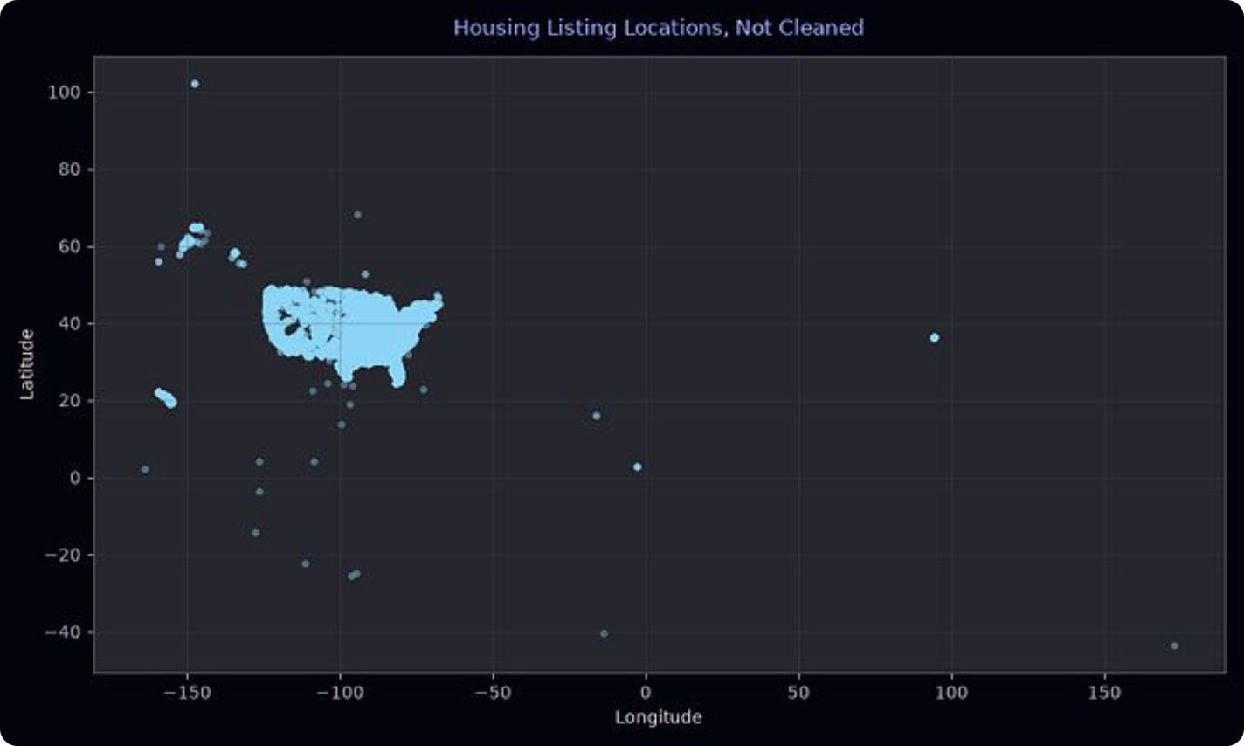
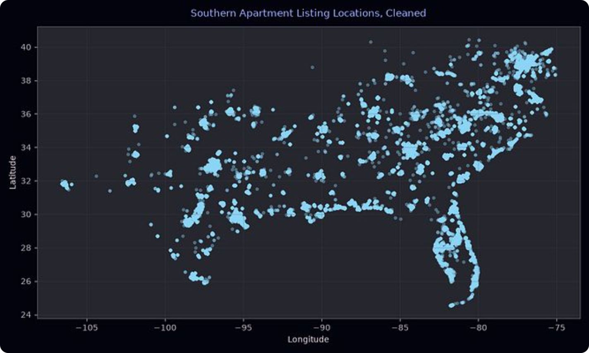
4. Phase 4.0 — Modeling & Viz
Key Visualizations
Geographic Filtering — Before vs After Cleaning

Slide 9
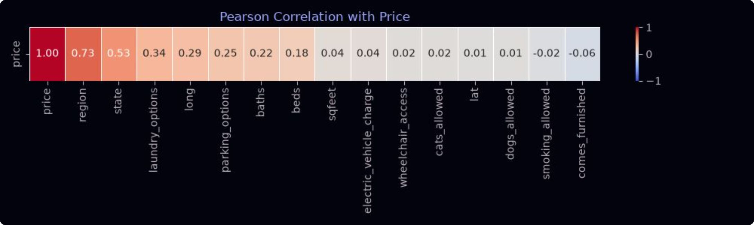
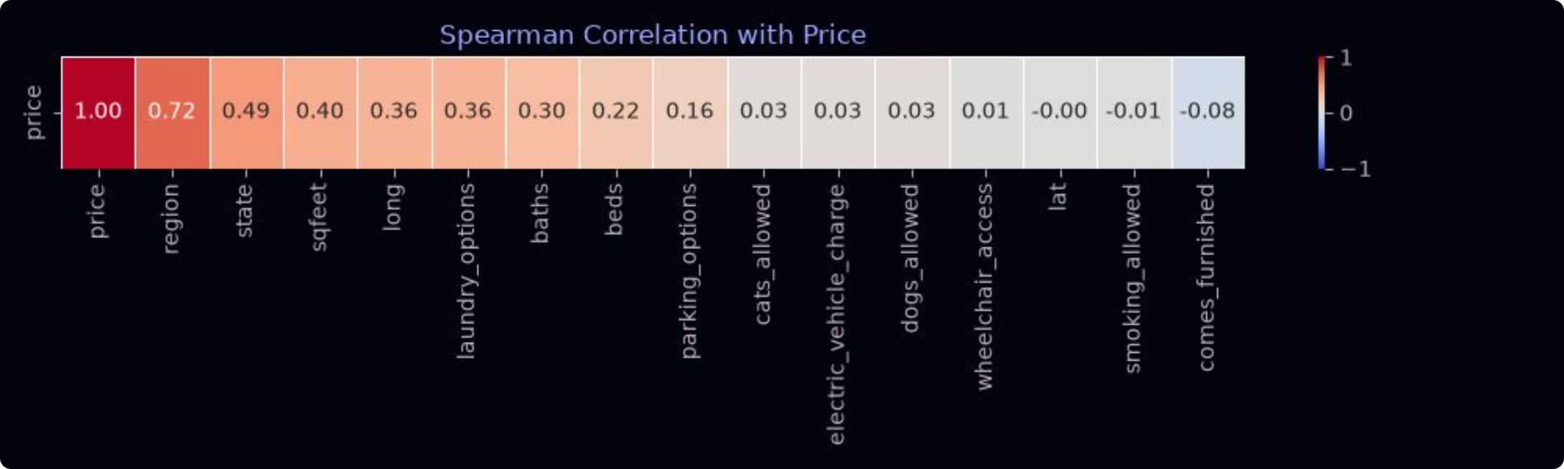
4. Phase 4.0 — Modeling & Viz
Key Visualizations
Correlation with Price

Slide 10
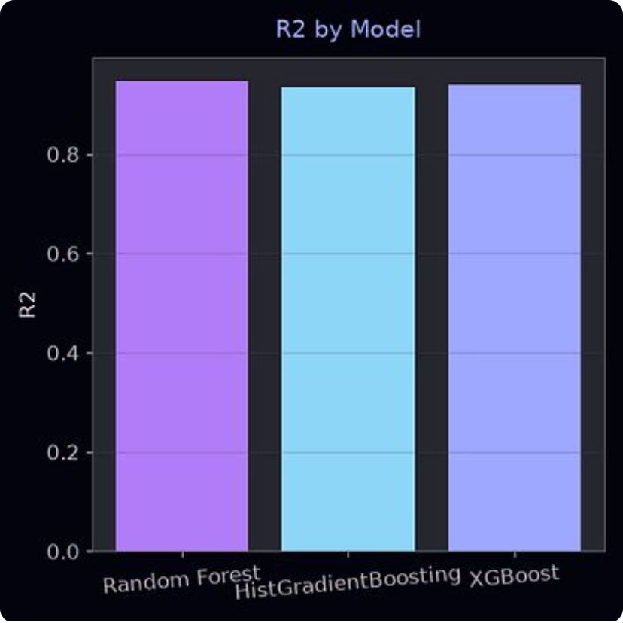
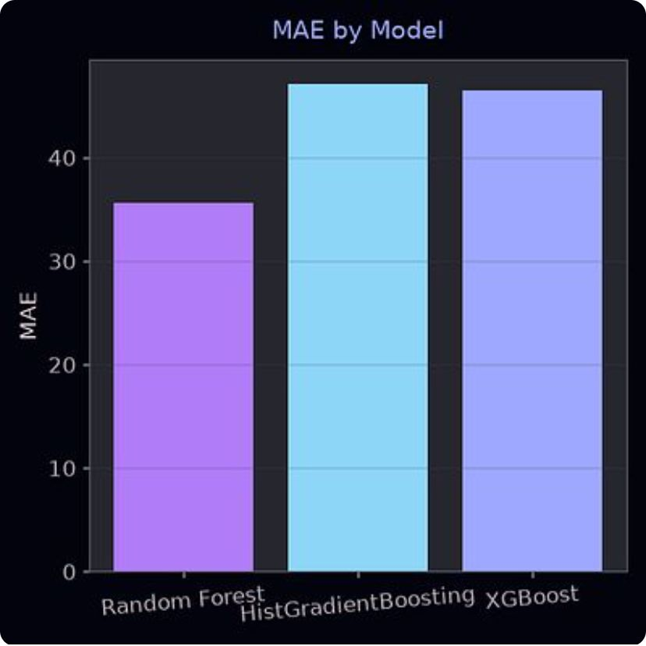
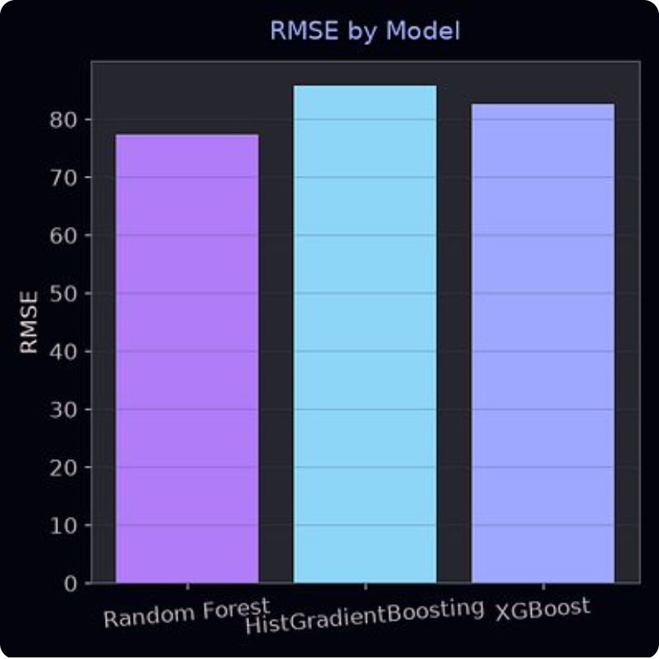
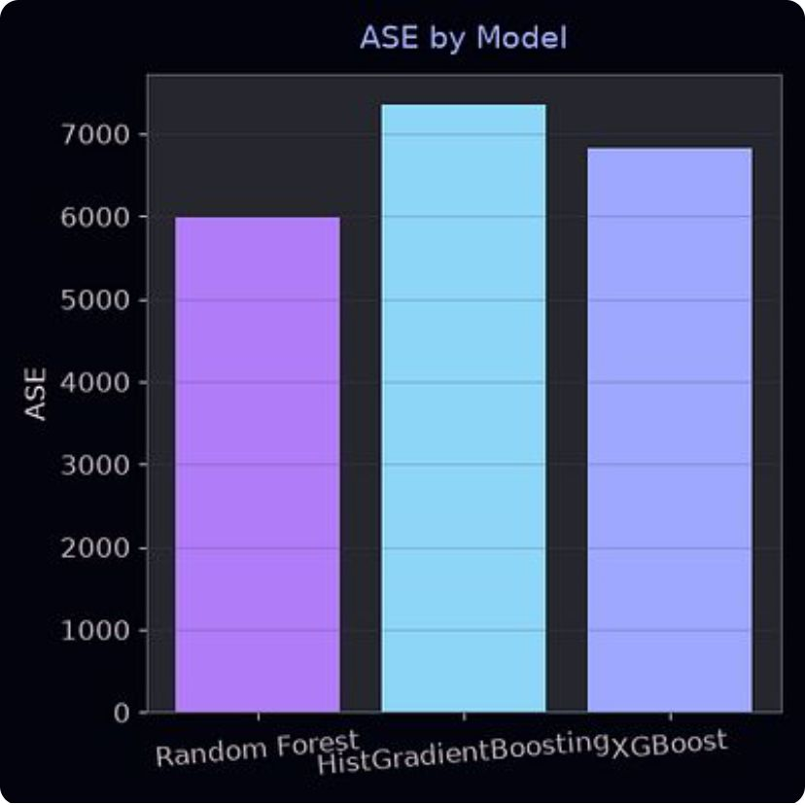
4. Phase 4.0 — Modeling & Viz
Key Visualizations
Model Performance Comparison

Slide 11
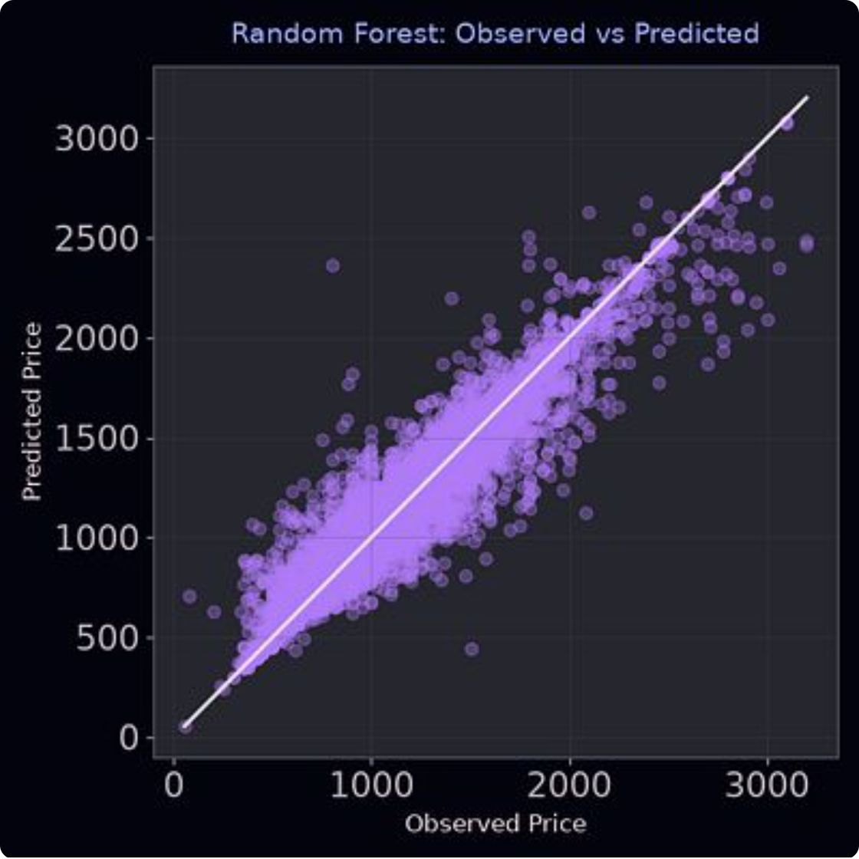
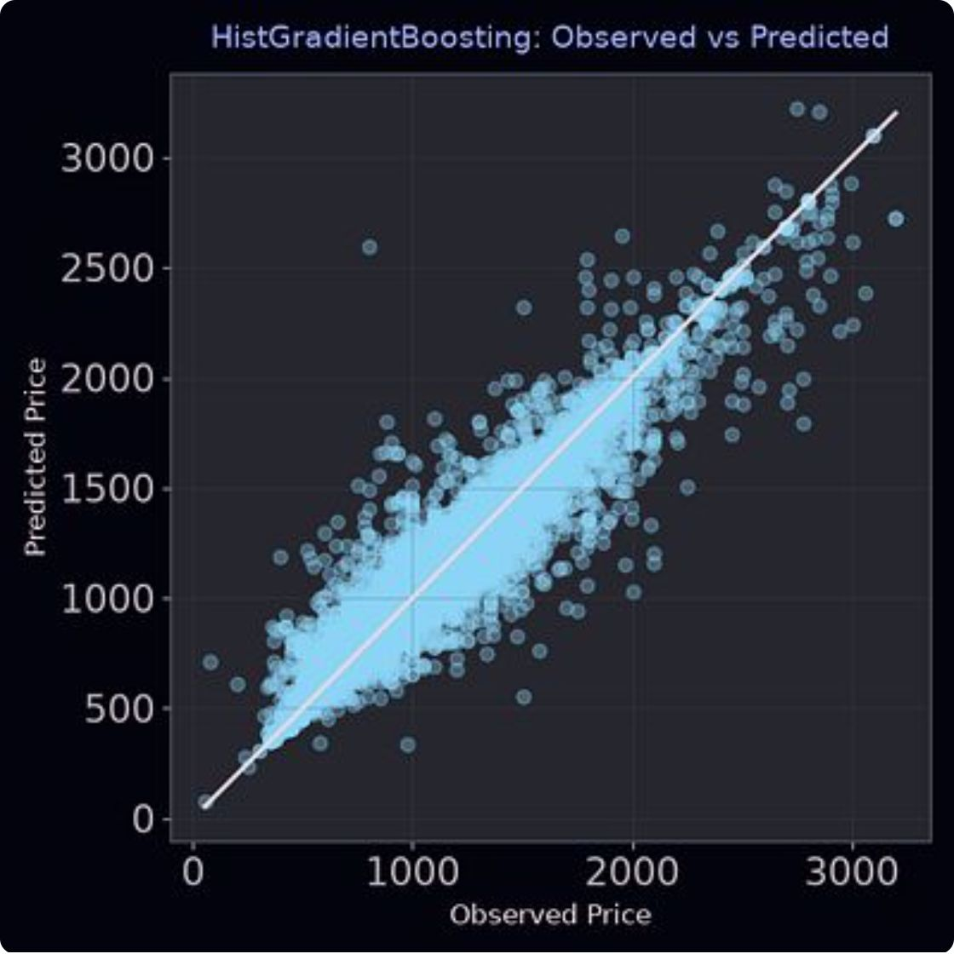
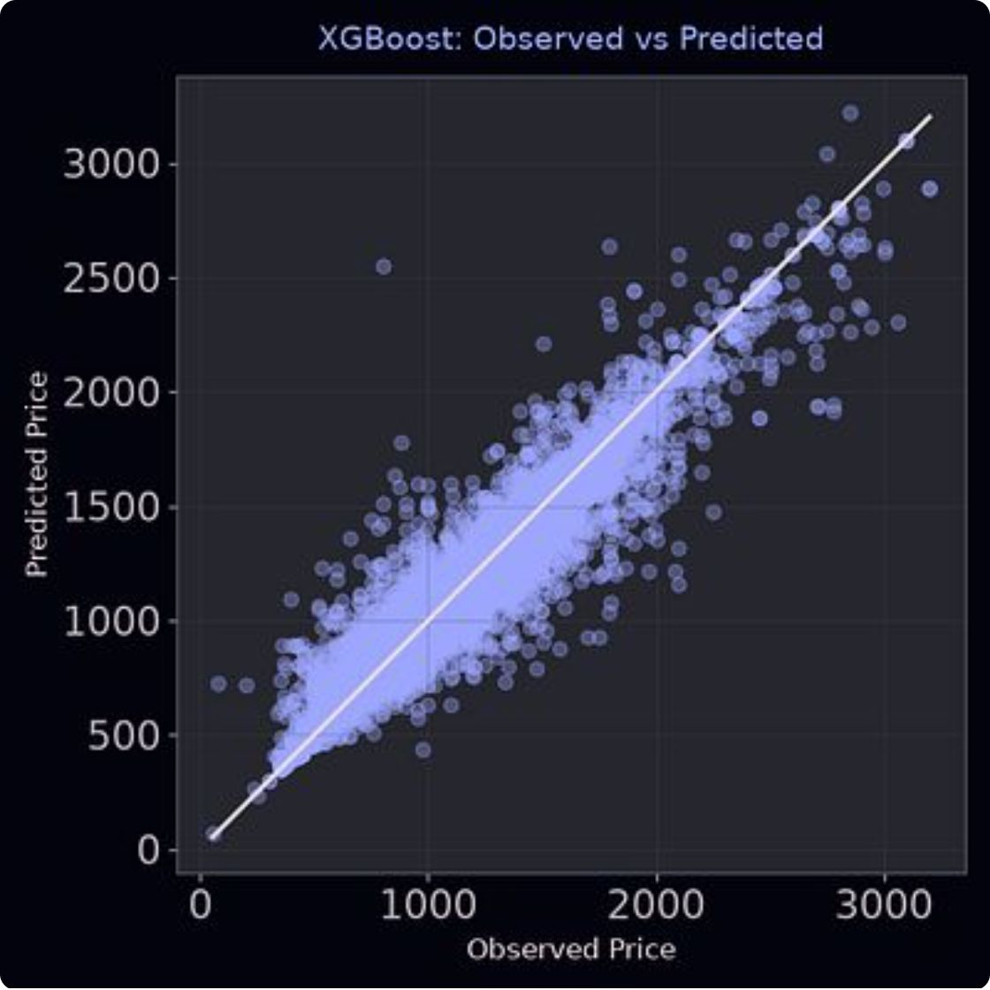
4. Phase 4.0 — Modeling & Viz
Key Visualizations
Observed vs Predicted (all 3 models)
Feature Importance (Top 4 per model)

Slide 12
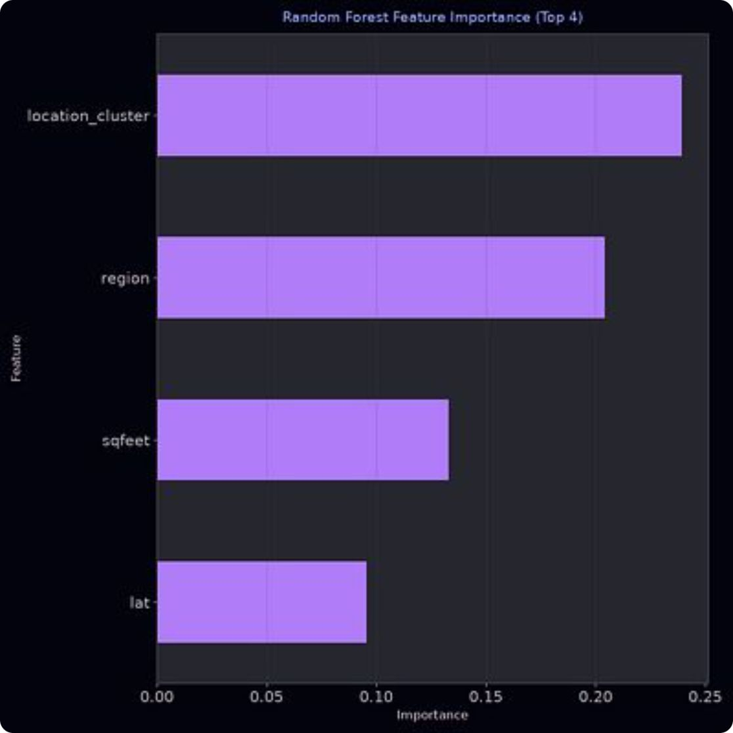
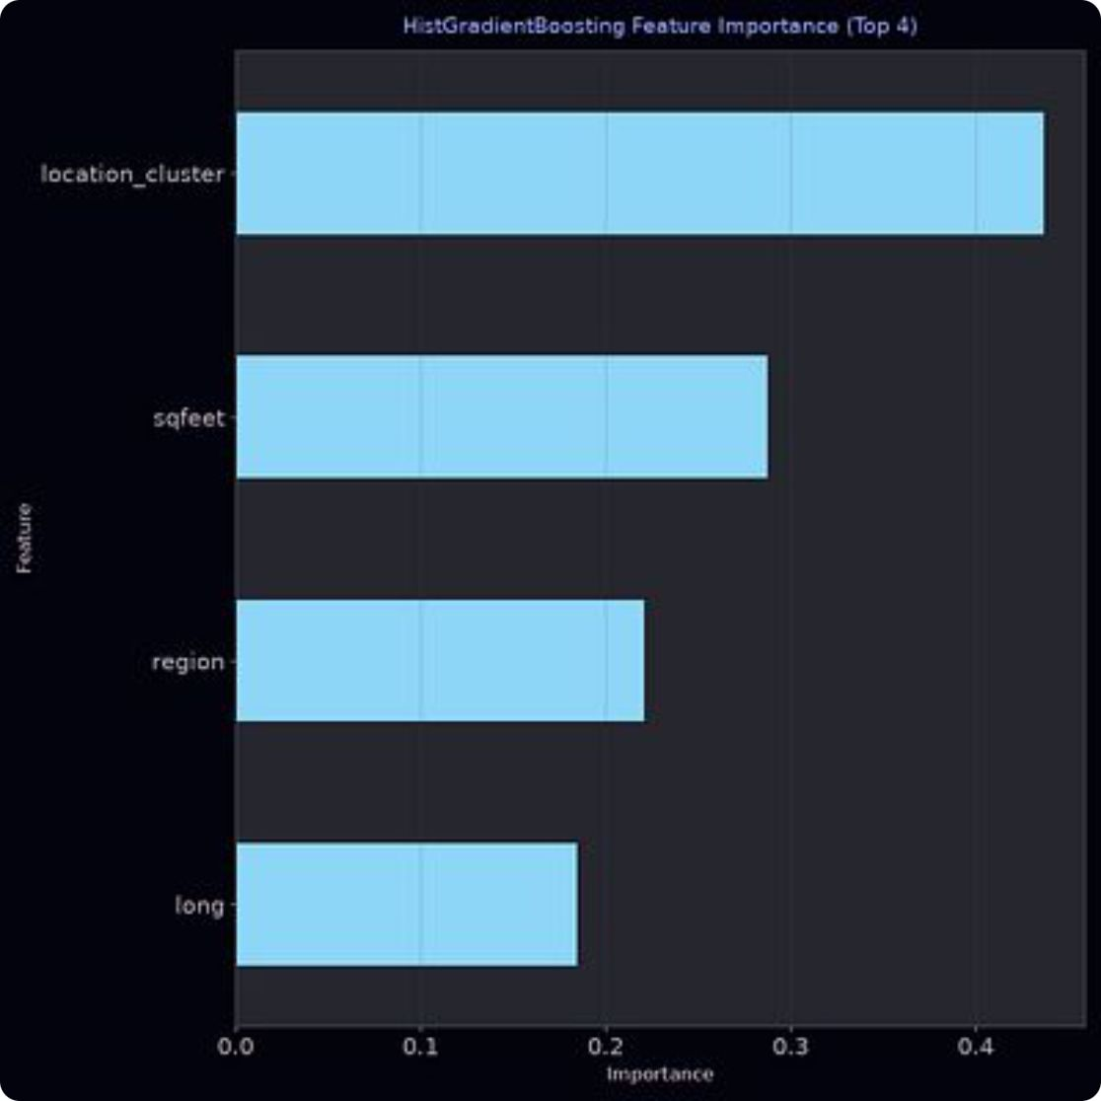
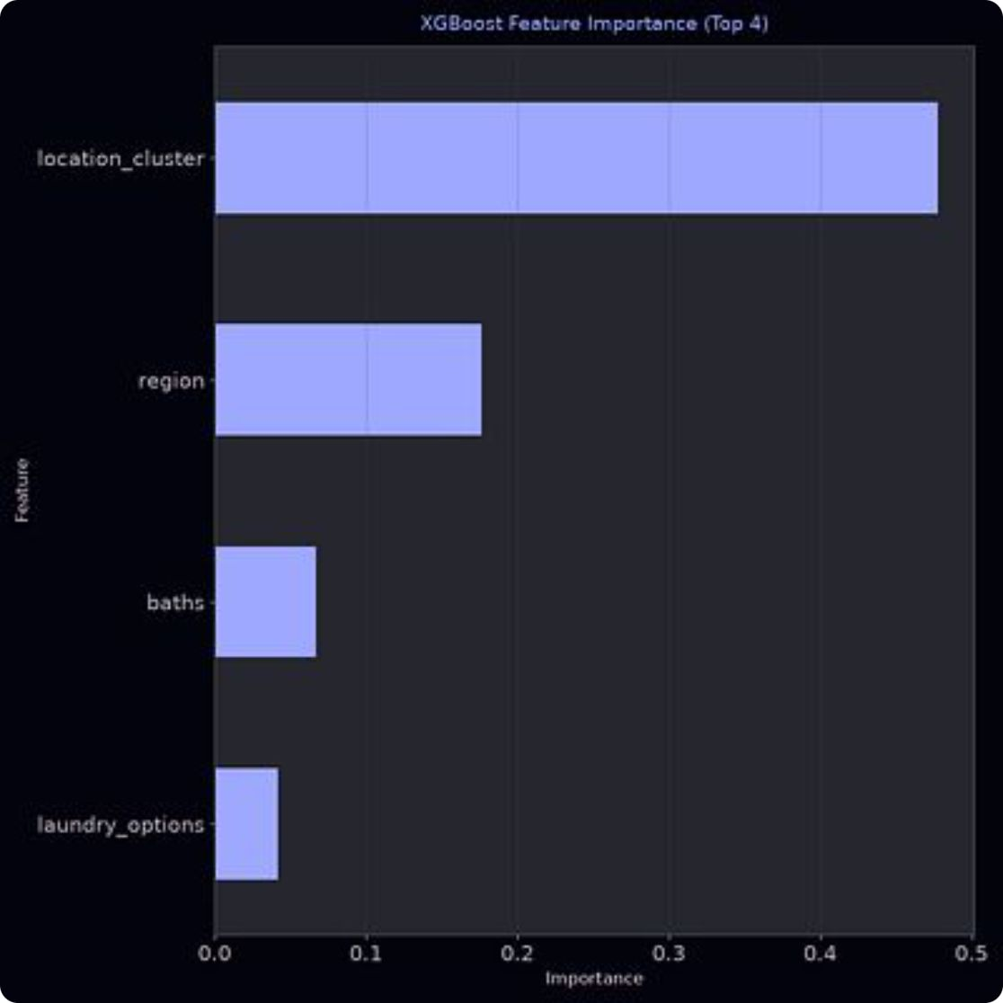
4. Phase 4.0 — Modeling & Viz
Key Visualizations
Feature Importance (Top 4 per model)

Slide 13
4. Phase 4.0 — Modeling & Viz
Business Insights
Location dominates pricing
Size matters, but diminishing returns
The geographic cluster alone explains more variance than any other single feature. A unit in an expensive neighborhood commands premium regardless of its physical characteristics
Square footage and bedroom count are the second- and third-strongest predictors, but the marginal price increase per additional bedroom decreases beyond 3 bedrooms
Amenities have limited standalone impact
Business impact
Property investors should prioritize location over renovations; renters can find better value by looking slightly outside premium clusters for similar-sized units
Pet policies, laundry options, parking, and wheelchair access each contribute modestly; they matter most in combination rather than individually

Slide 14
4. Phase 4.0 — Modeling & Viz
Feature Importance Rankings
Feature
RF
HistGB
XGB
location_cluster
1
1
1
region
2
3
2
sqfeet
3
2
—
lat
4
—
—
long
—
4
—
baths
—
—
3
laundry_options
—
—
4
(Rankings across all three models. Blank = outside top 4.)

Slide 15
5. LIVE Demonstration

Slide 16


6. Lessons Learned
Technology
Target encoding and K-Means location clustering were critical for capturing nuanced patterns in the data. HistGradientBoosting provided a significant speed advantage over standard gradient boosting while maintaining accuracy.
Management
CRISP-DM provided a structured framework that prevented scope creep and kept the project on track through all six phases.
Personal
Adding K-Means location clustering was the single most impactful engineering decision — models without it performed noticeably worse, and location_cluster became the #1 predictor across all three models. Switching IQR outlier handling from national-level to region-specific also improved results, showing that local market dynamics matter in data preparation. One limitation I observed: all three models are less precise for the most expensive listings, with observed-vs-predicted spread widening at higher price points.

Slide 17
7. Conclusion
Did the project meet its stated goals?
Did the project meet its stated goals? Yes.
Business goal achieved
Data mining goal achieved
I identified that location, square footage, and bedroom count are the dominant drivers of rental price in the Southern US
All three models successfully predicted rental price from available features, and the feature importance rankings identified location, square footage, and bedroom count as the top drivers — fulfilling the analytical goal of producing actionable rankings
What did the project show? Rental pricing in the Southern US is heavily location-driven, but within a given area, apartment size and bedroom count are the most actionable levers. Amenities like pet policies and parking matter but are secondary.
Final thoughts: The project demonstrated that ensemble methods with thoughtful feature engineering can explain ~95% of rental price variance using publicly available Craigslist data. This approach could be extended to a real-time pricing tool for property managers or integrated into rental listing platforms to suggest optimal listing prices.

